Slide 1
Building Fiscal Capacity in the D.R. Congo: Insights on political participation, role of local leaders, and optimal tax rates
Jonathan Weigel, UC Berkeley
May 10, 2023

Slide 2

Overview: Three studies with the Provincial Government of Kasaï Central, DRC
Deep collaboration with provincial tax authorities across 2 tax campaigns:
2016 campaign
  Does taxation increase political participation in fragile states?
2018 campaign
  Can low-capacity governments increase tax revenue by delegating collection to local leaders?
  How should fragile states set tax rates and enforcement?

Slide 3

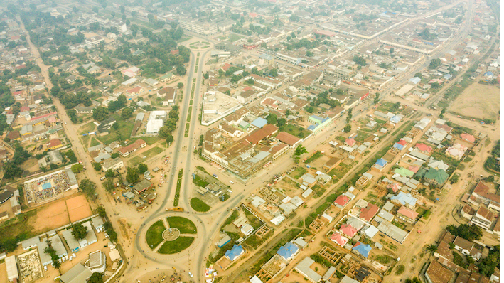
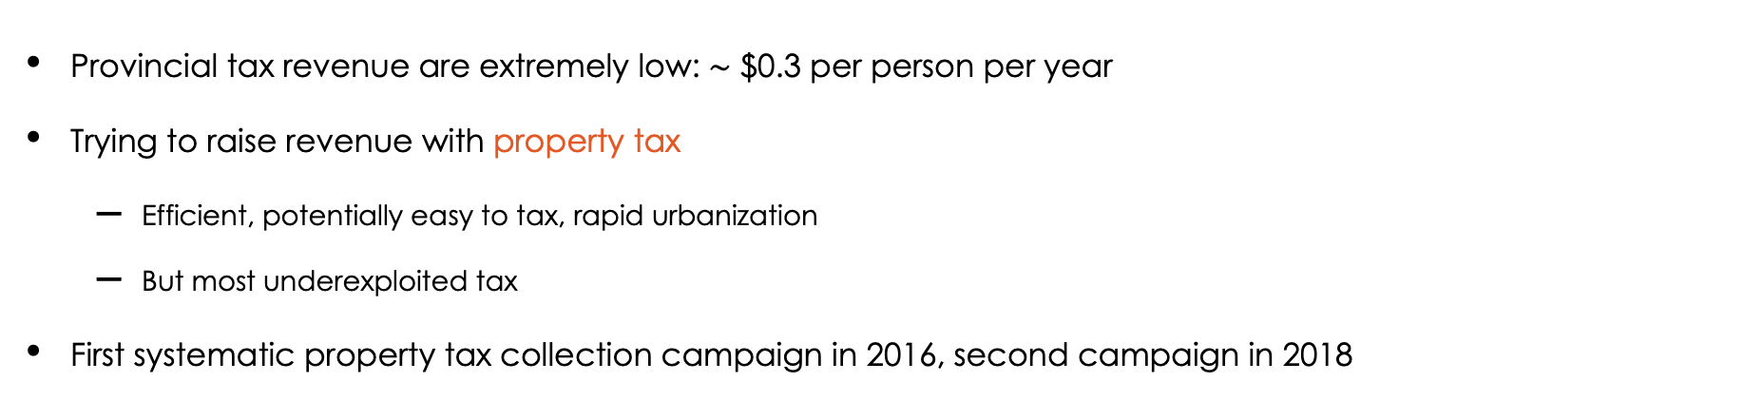
Context: A Weak State with Near-Zero Tax Compliance
Provincial tax revenue are extremely low: $\sim$ $0.3 per person per year
Trying to raise revenue with property tax
  Efficient, potentially easy to tax, rapid urbanization
  But most underexploited tax
First systematic property tax collection campaign in 2016, second campaign in 2018

Slide 4
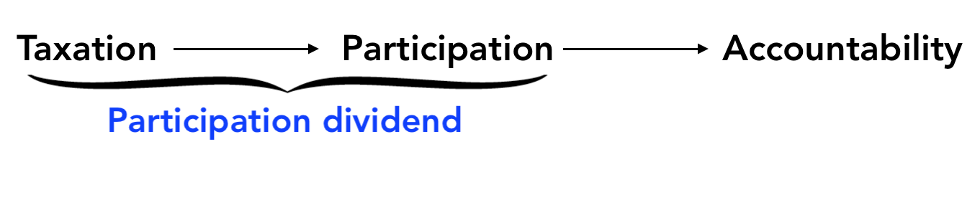
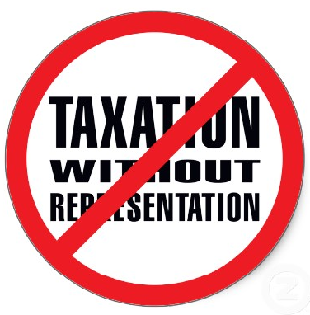
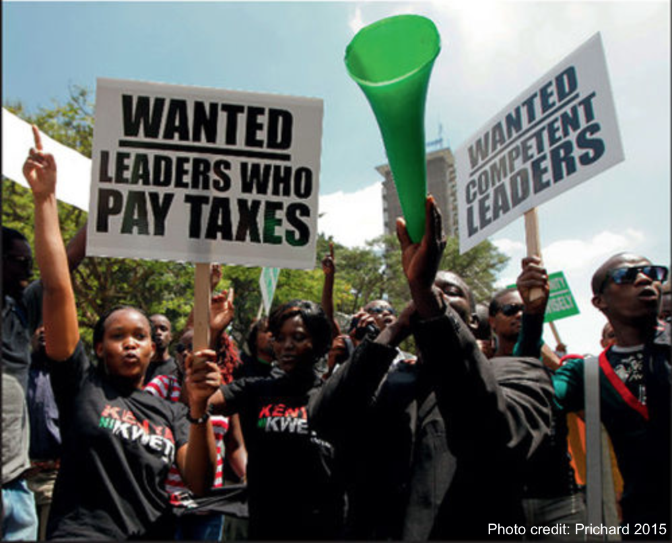
Study 1: Policy Issue: The Participation Dividend

Slide 5
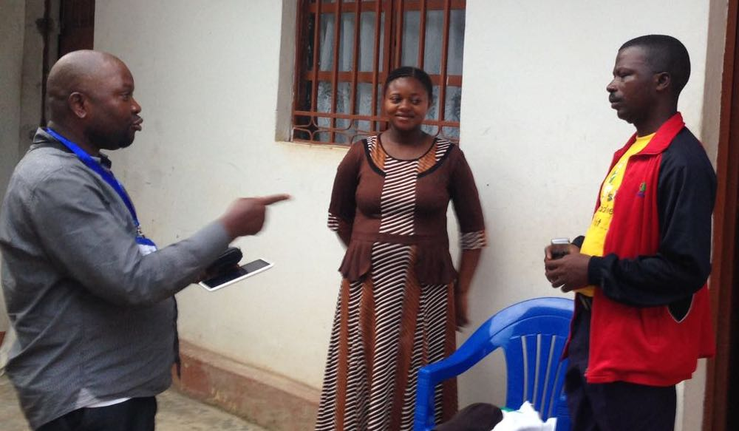
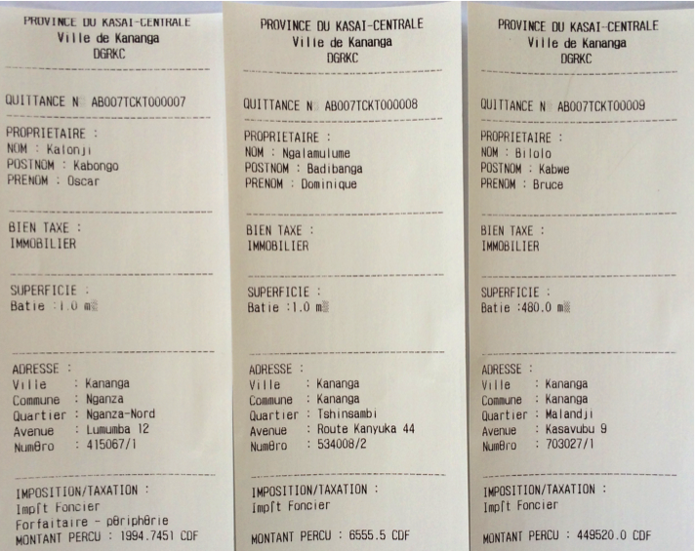
Design: Treatment – Door-to-Door Property Tax Collection
Collectors work in groups of two in both steps:
1. Registration: assign tax IDs, construct property roll
2. Collection: door-to-door tax appeals
Collectors use tablets and receipt printers paper trail
Randomized at the neighborhood level

Slide 6
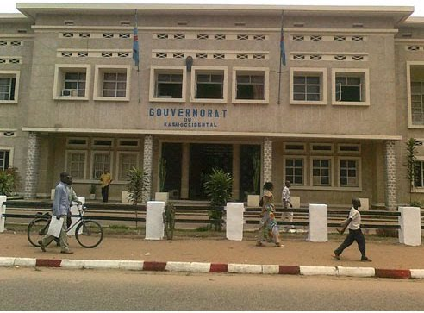
Design: Control – Old Declarative System
Citizens supposed to pay themselves at the bank
Not enforced among private citizens
Compliance near zero

Slide 7
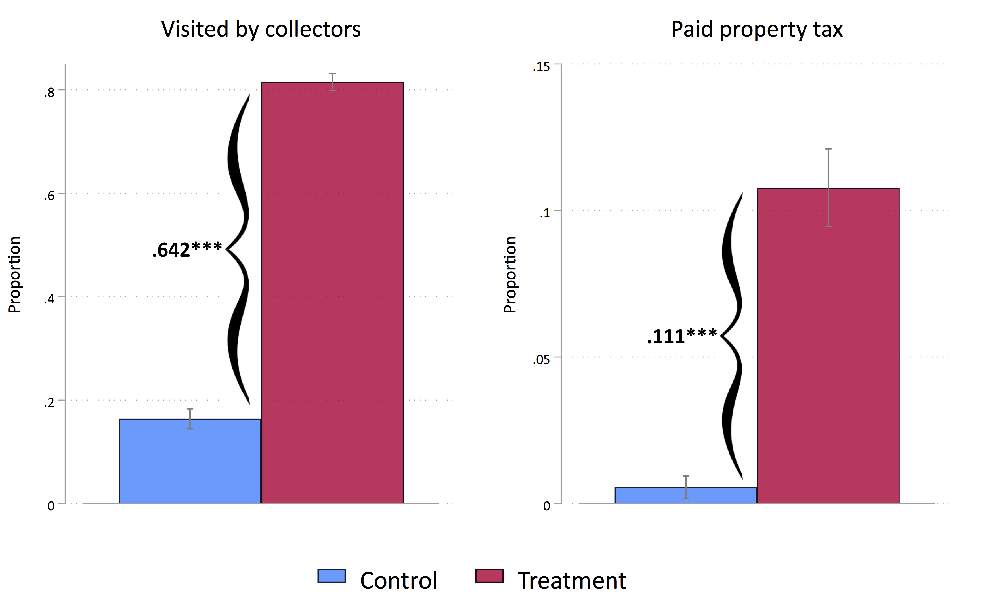
Results
Campaign increased tax collector visits and tax compliance

Slide 8
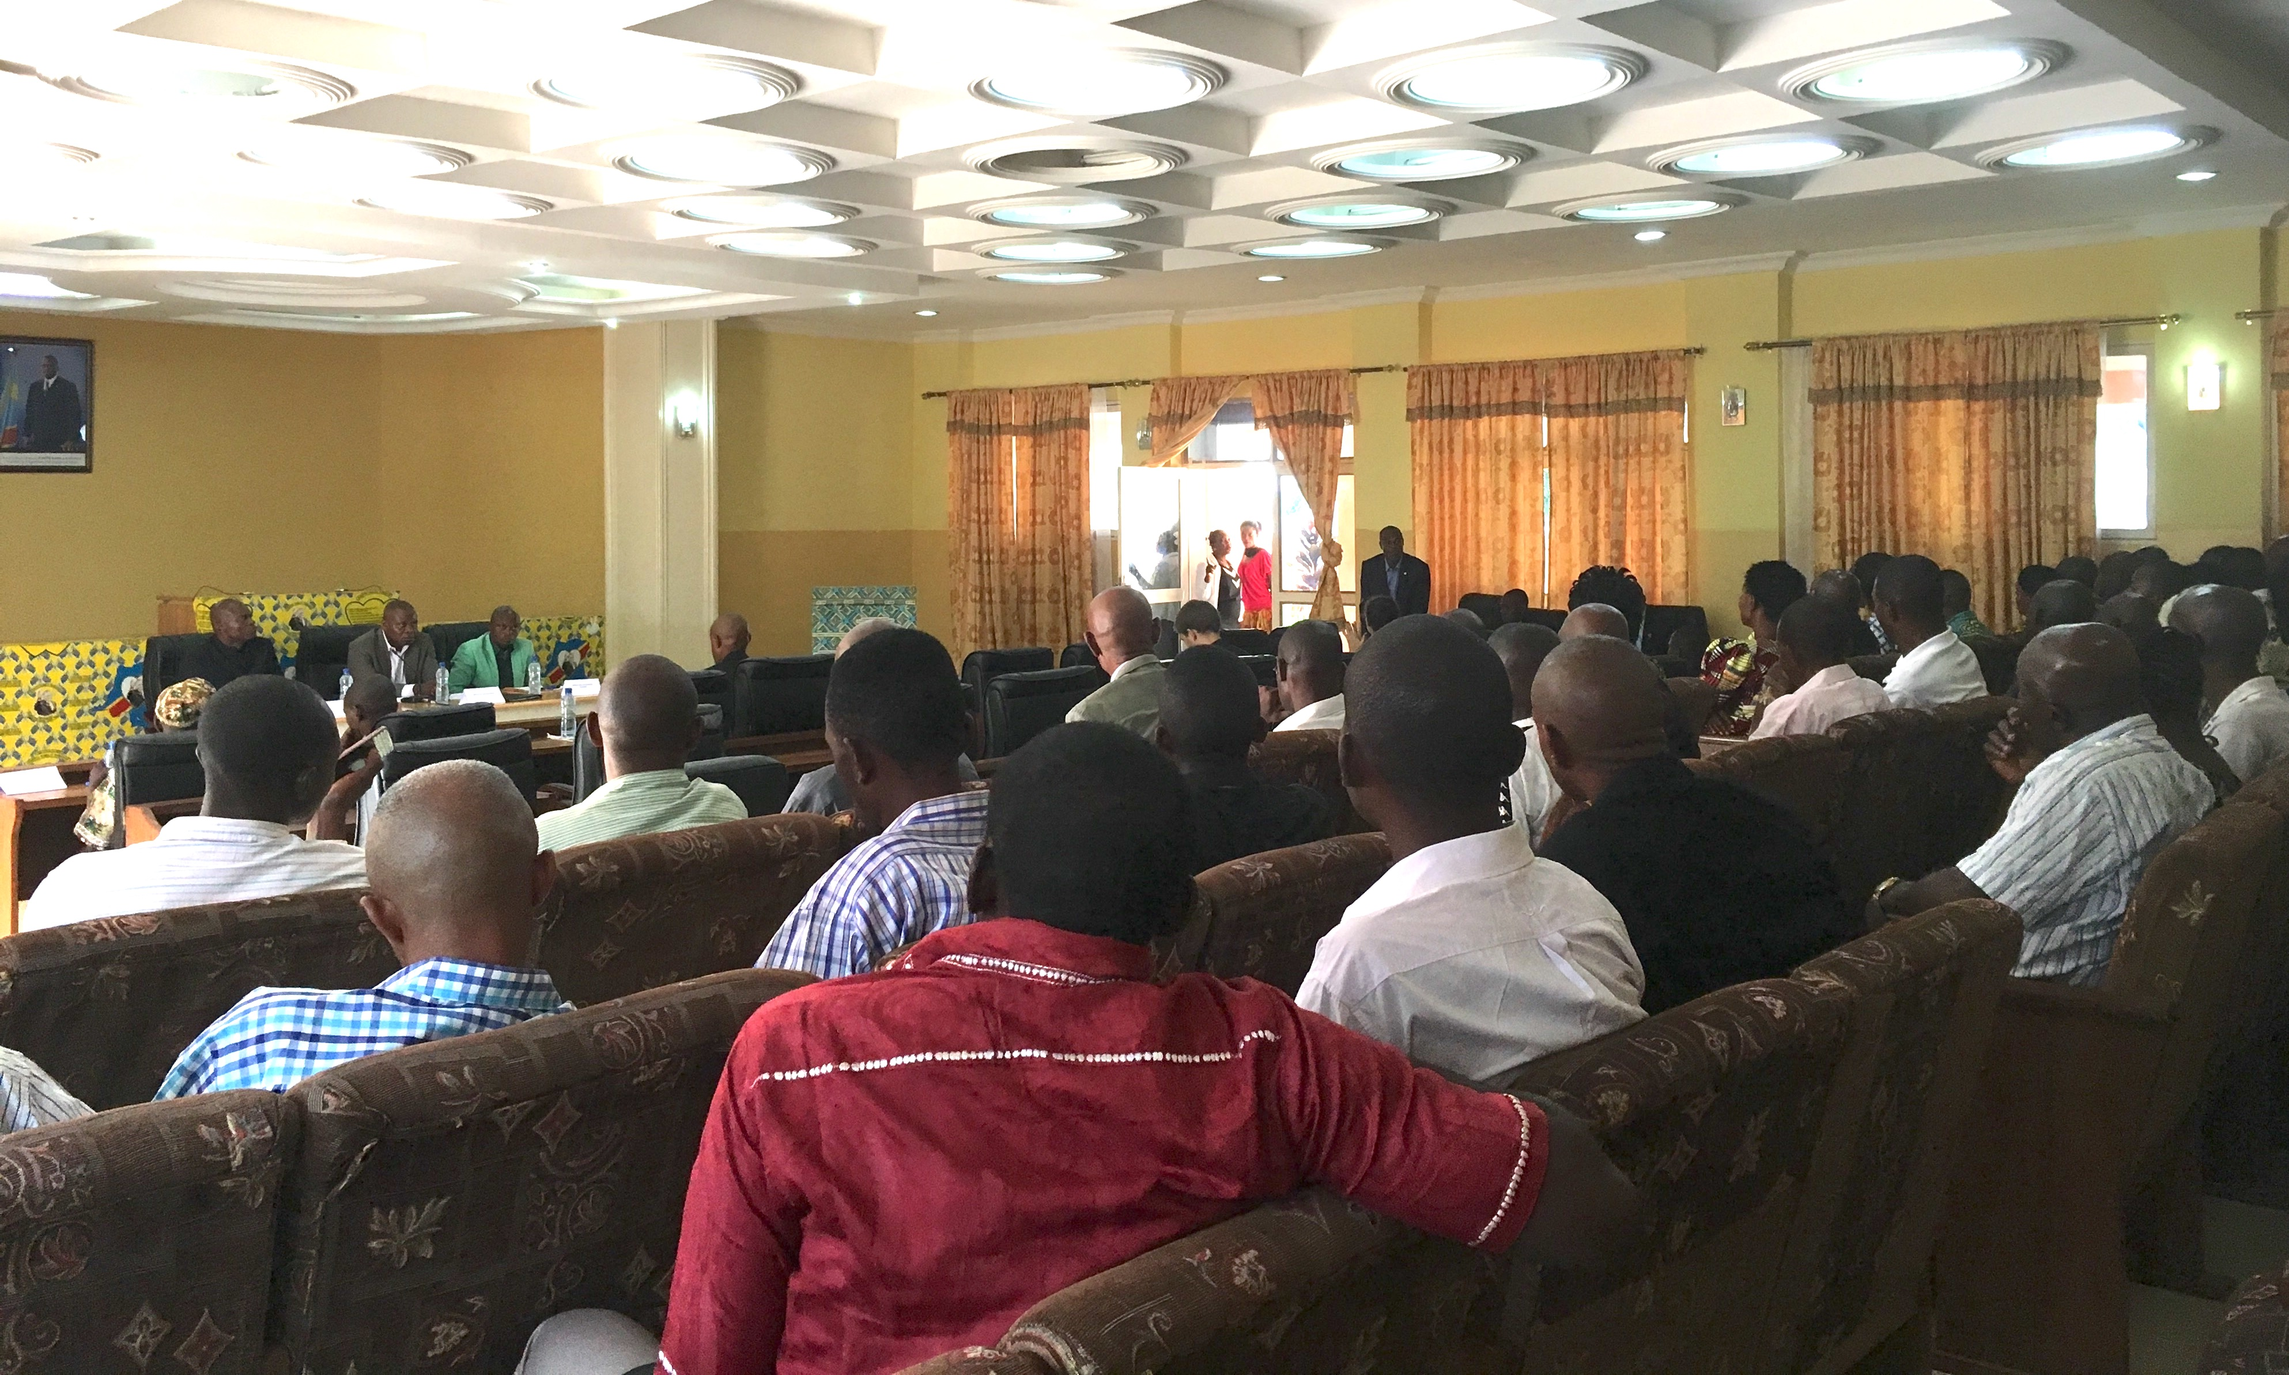
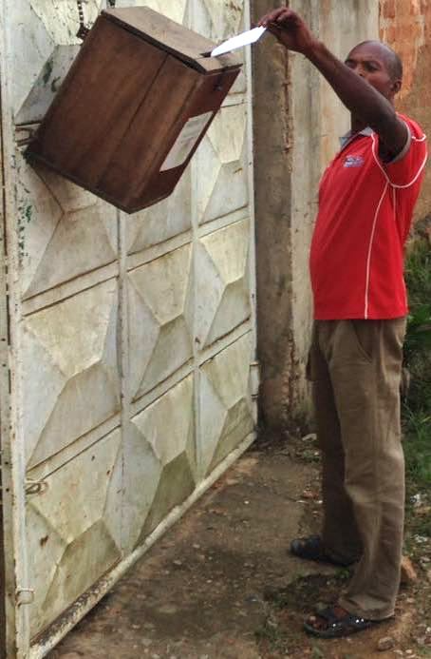
Measuring participation: townhalls and evaluations
Townhalls hosted by provincial government. Anonymous evaluations -> governor.
Attendance indicates costly participation 6-8 months after tax collection (not short term effect)
24.9% of respondents attend townhall, 13.6% submit evaluation

Slide 9
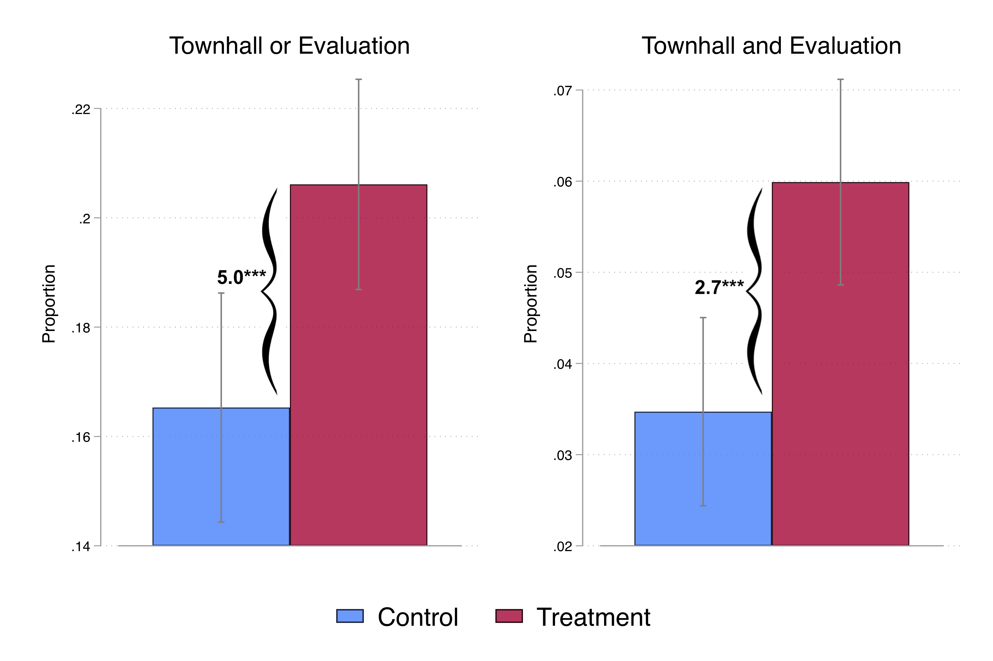
Results
Campaign increased tax collector visits and tax compliance
Citizens increased their costly political participation

Slide 10
Policy Lessons and Implications
In low-capacity states, efforts to systematize tax collection can:
  Increase tax revenue
  Increase citizen engagement and demand for good government
  Increase the perceived responsibility of government in service provision

Slide 11
Study 2: Local Leaders as Tax Collectors?
Experimental design: 356 neighborhoods (49,921 properties) assigned col. type
Central = tax ministry agents
Local = neighborhood chiefs
  Collectors register properties and make door-to-door appeals
  Everything else held constant: training, protocol, technology
Why this approach?
"At-scale” randomization provides a true test of policy

Slide 12
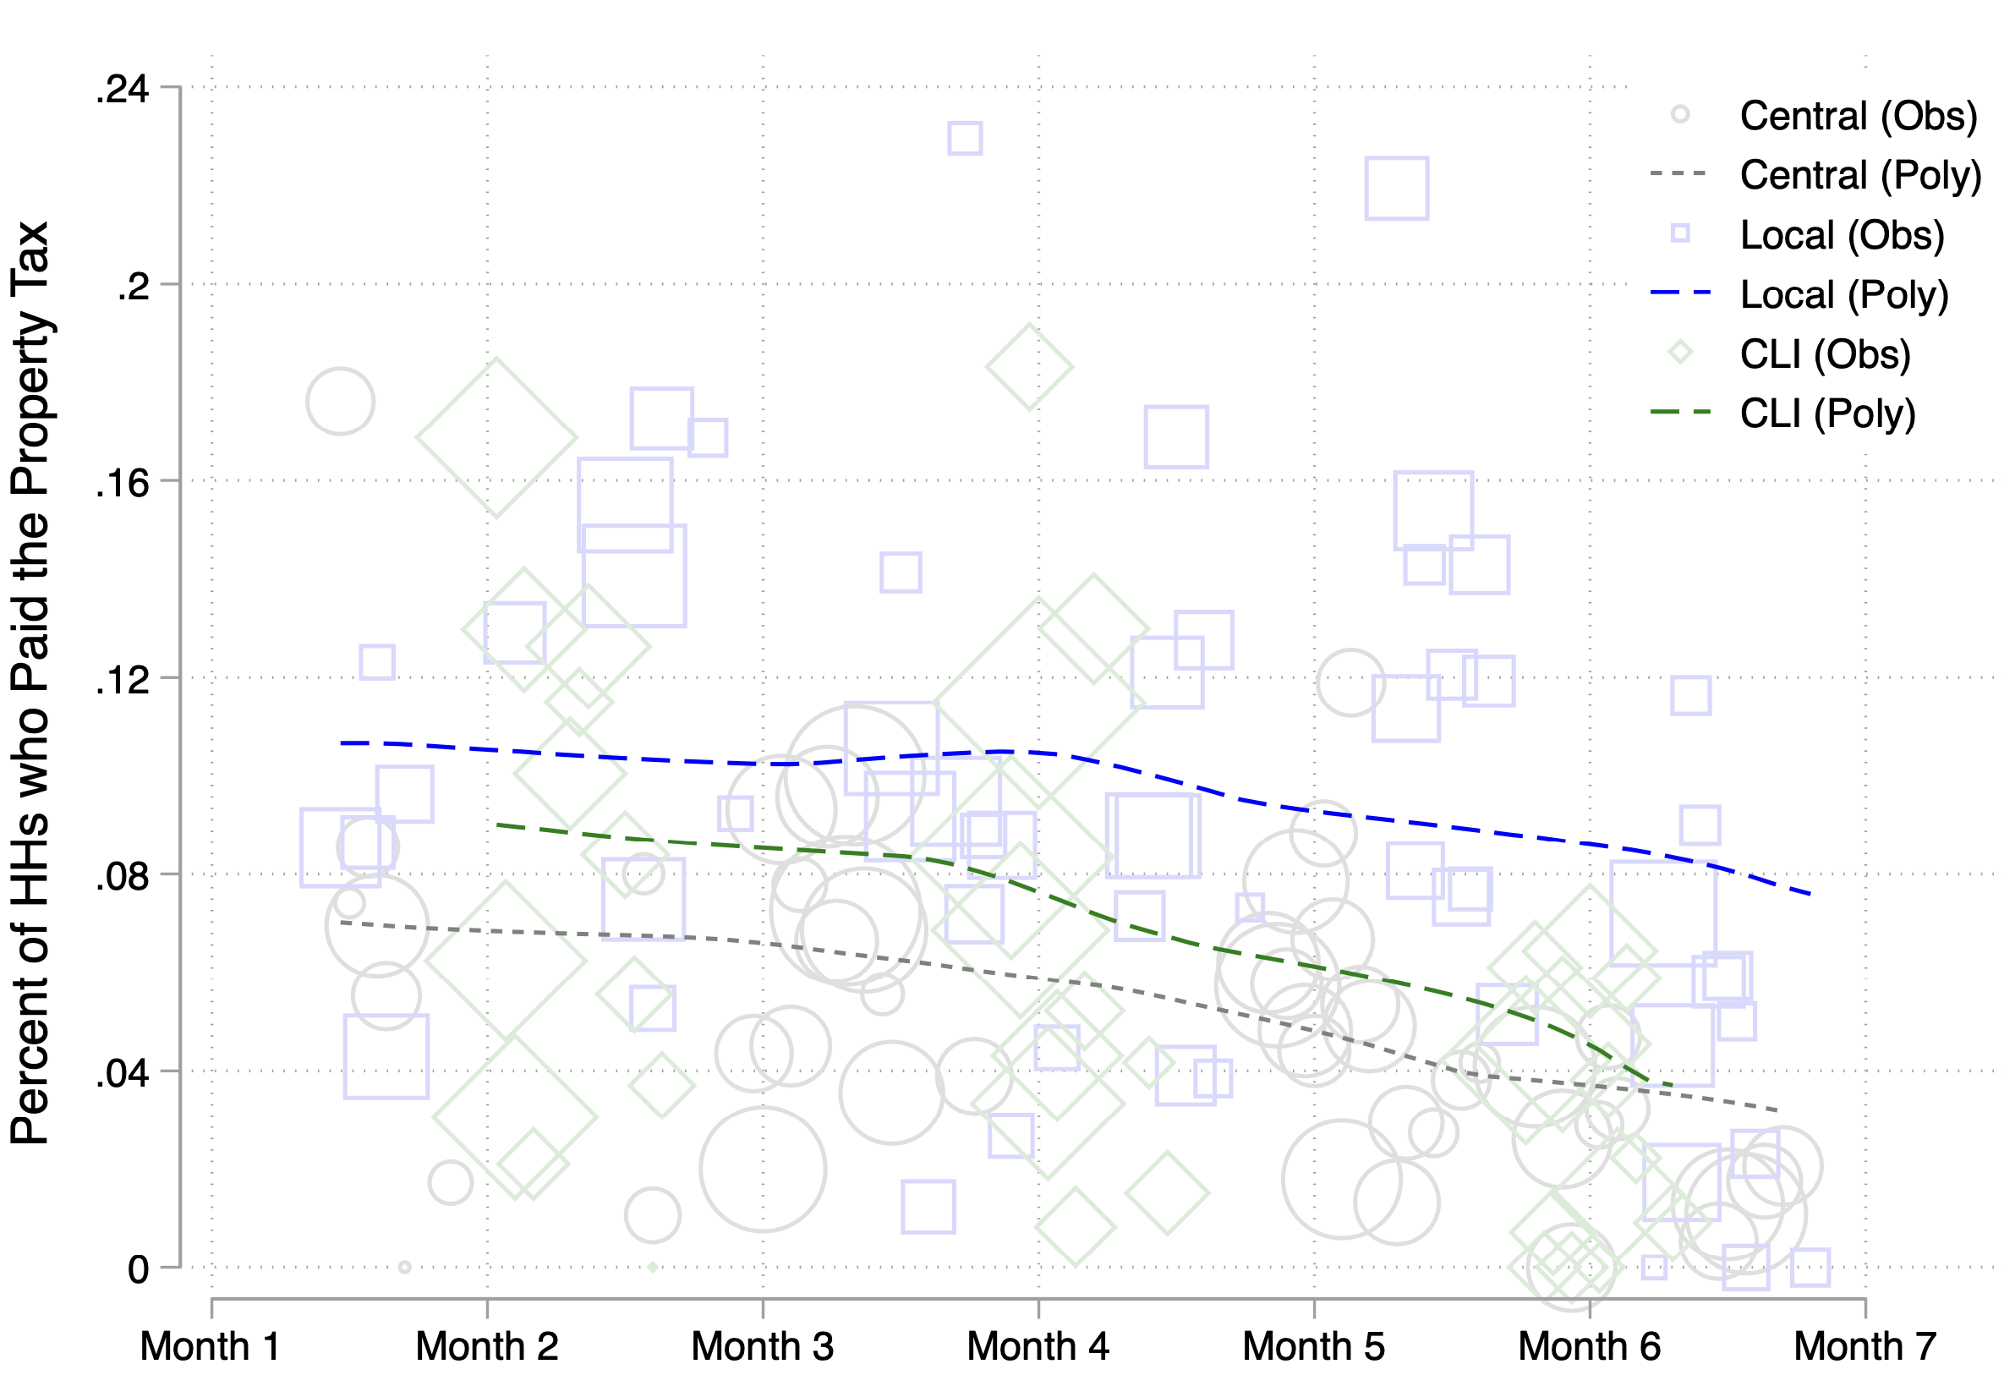
Results: Chiefs Raise More Revenue
Local ↑ tax compliance by 51%, revenues by 44%
Benchmark: 5x’s > standard enforcement messages on tax letters
Other downsides to chief collection?
  Bribes: Collect 2 ppt more (from 1% to 3% HHs)
  Views of govt: No backfiring, in fact ↑ trust
  Distributional impacts: Chiefs tax lower-value properties more, but taxpayers across treatment do not differ in income

Slide 13

Why Do Chiefs Collect More?
More tax visits? No diffs by ex/intensive margin
Local info → better targeting? Test hybrid “Central + Local Info” (CLI) arm
  State agents consult chief on HHs’ ability & WTP
  C<CLI but <L
  CLI resembles L in targeting
More persuasive? C = L when targeting neutralized

Slide 14
Policy lessons & implications
Evaluating collector types: chief raise revenue, but collect more bribes
  Cost-effectiveness: return on additional $1 is 53% higher in Local
  Prov. Gov’t would need to weigh the cost of bribes 15x more than an additional $1 in net revenue to prefer state agents over chiefs
Short run: govts in fragile and very low-capacity settings are likely to benefit from collaborating with local leaders in tax collection in urban and peri-urban settings
Longer run: unlikely that chief collection is a path to building a modern “tax state”
  Third-party information – from expanding formal sector and financial development – likely overtake chiefs’ informational advantages
  Chief collection is a viable short-run option in low-capacity settings, but should not crowd out investments in enforcement capacity

Slide 15
Study 3: What tax rate maximizes revenue in a low enforcement capacity setting?
Status Quo Rate
50% Reduction
Tax liability: written on tax letter and randomly assigned
  Status quo v. 17%, 33%, or 50% reduction
  About 0.34% of property value (USA: 0.27%-2.44%)

Slide 16
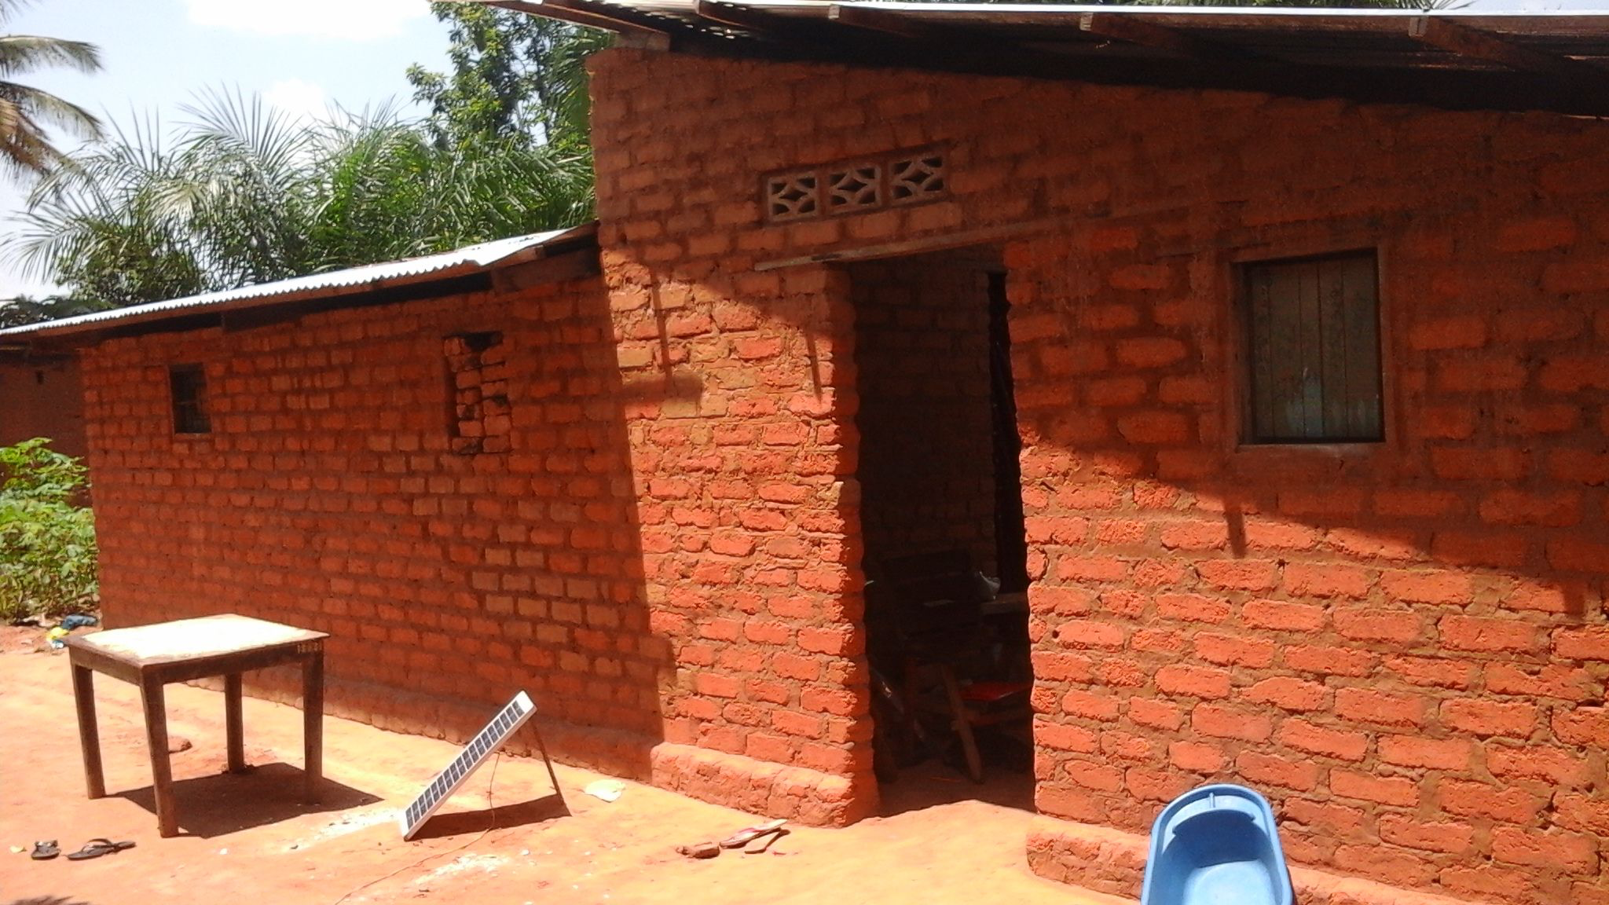

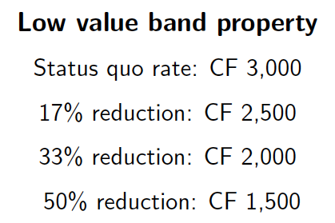
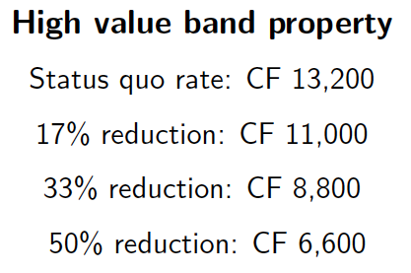
Design: Randomized Abatements at the Property Level
Control Group:

Slide 17
Design: Randomized Abatements at the Property Level
Control Group:
Treatment Groups:

Slide 18
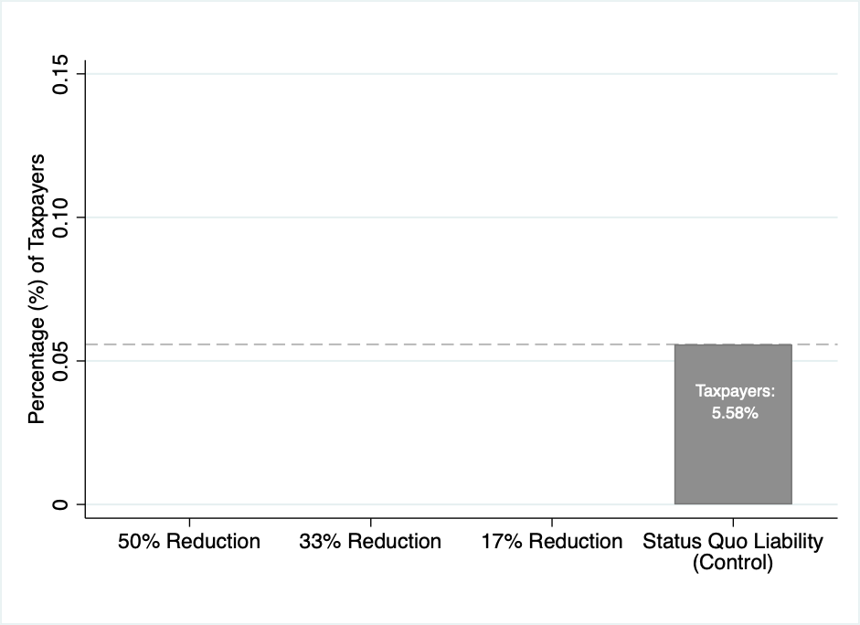
Results: Compliance Increases with Abatements

Slide 19
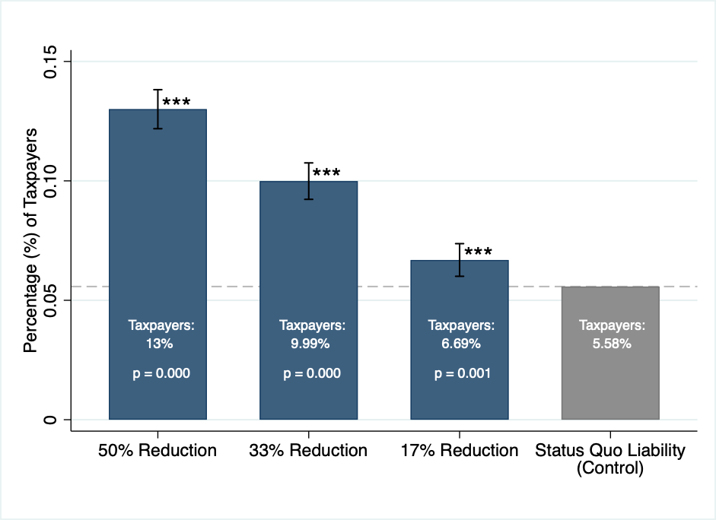
Results: Compliance Increases with Abatements

Slide 20
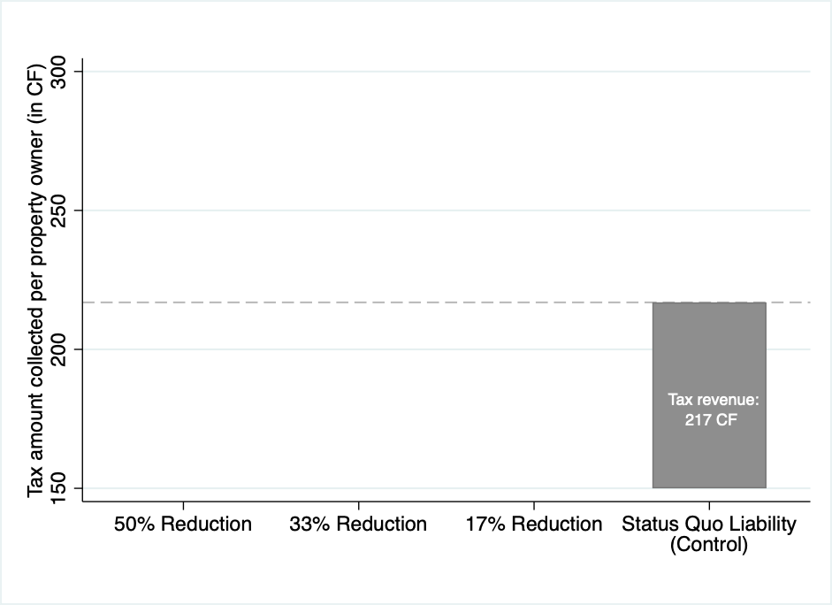
Results: Revenue Increases with Abatements

Slide 21
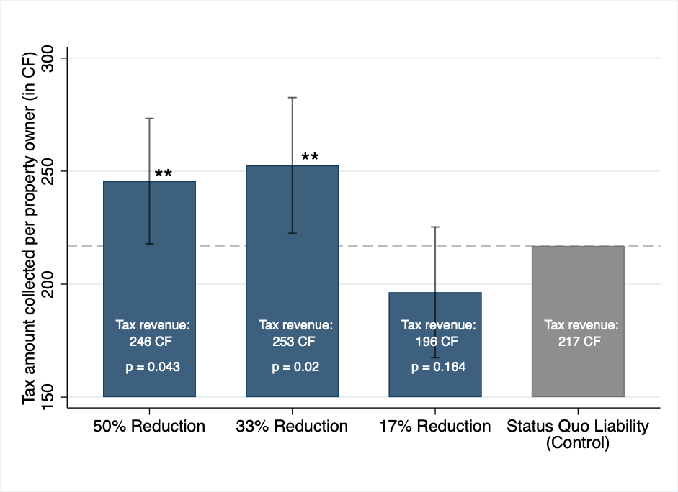
Results: Revenue Increases with Abatements
Reducing the tax rate by 34% would maximize tax revenue under enforcement conditions at the time

Slide 22
How Does the Rev. Max. Rate Vary with Enforcement?
When enforcement is low tax rates are above Can investment in enforcement capacity raise
Control Message
Enforcement Message
Randomly assigned messages on tax letters:
  Control Message: “Paying the property tax is important”
  Enforcement Message: “If you refuse to pay the property tax, you could be summoned to the tax ministry for investigation and audit”

Slide 23
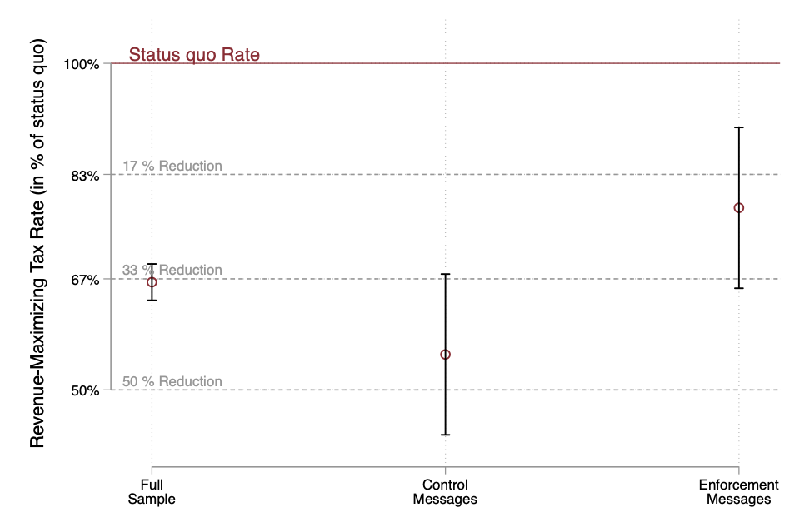
Results: Rev.-Maximizing Rate Increases with Enforcement
Increasing enforcement raised the revenue-maximizing tax rate
            Individuals receiving the enforcement message respond less to changes in tax liability → compliance remains higher even as tax rate increases
            Similar result using tax collector variation
Tax rates and enforcement are complementary policy levers

Slide 24
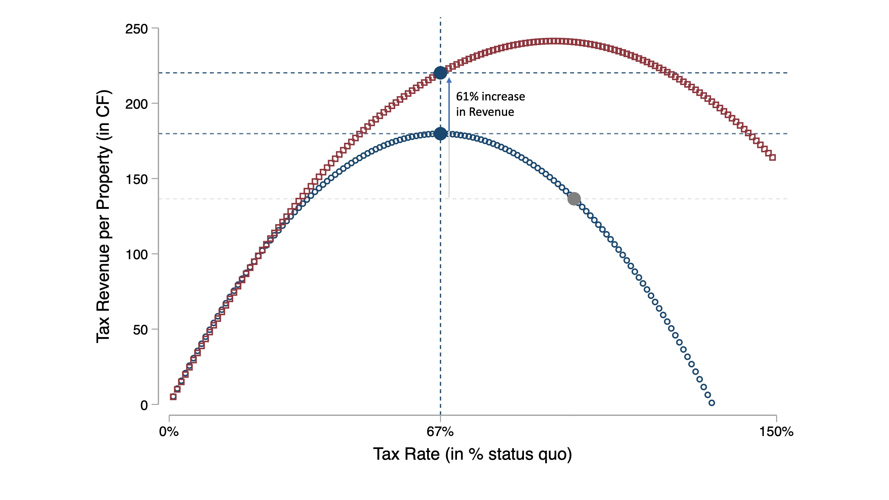
Policy Lesson: Independently Adjusting Rates and Enforcement

Slide 25
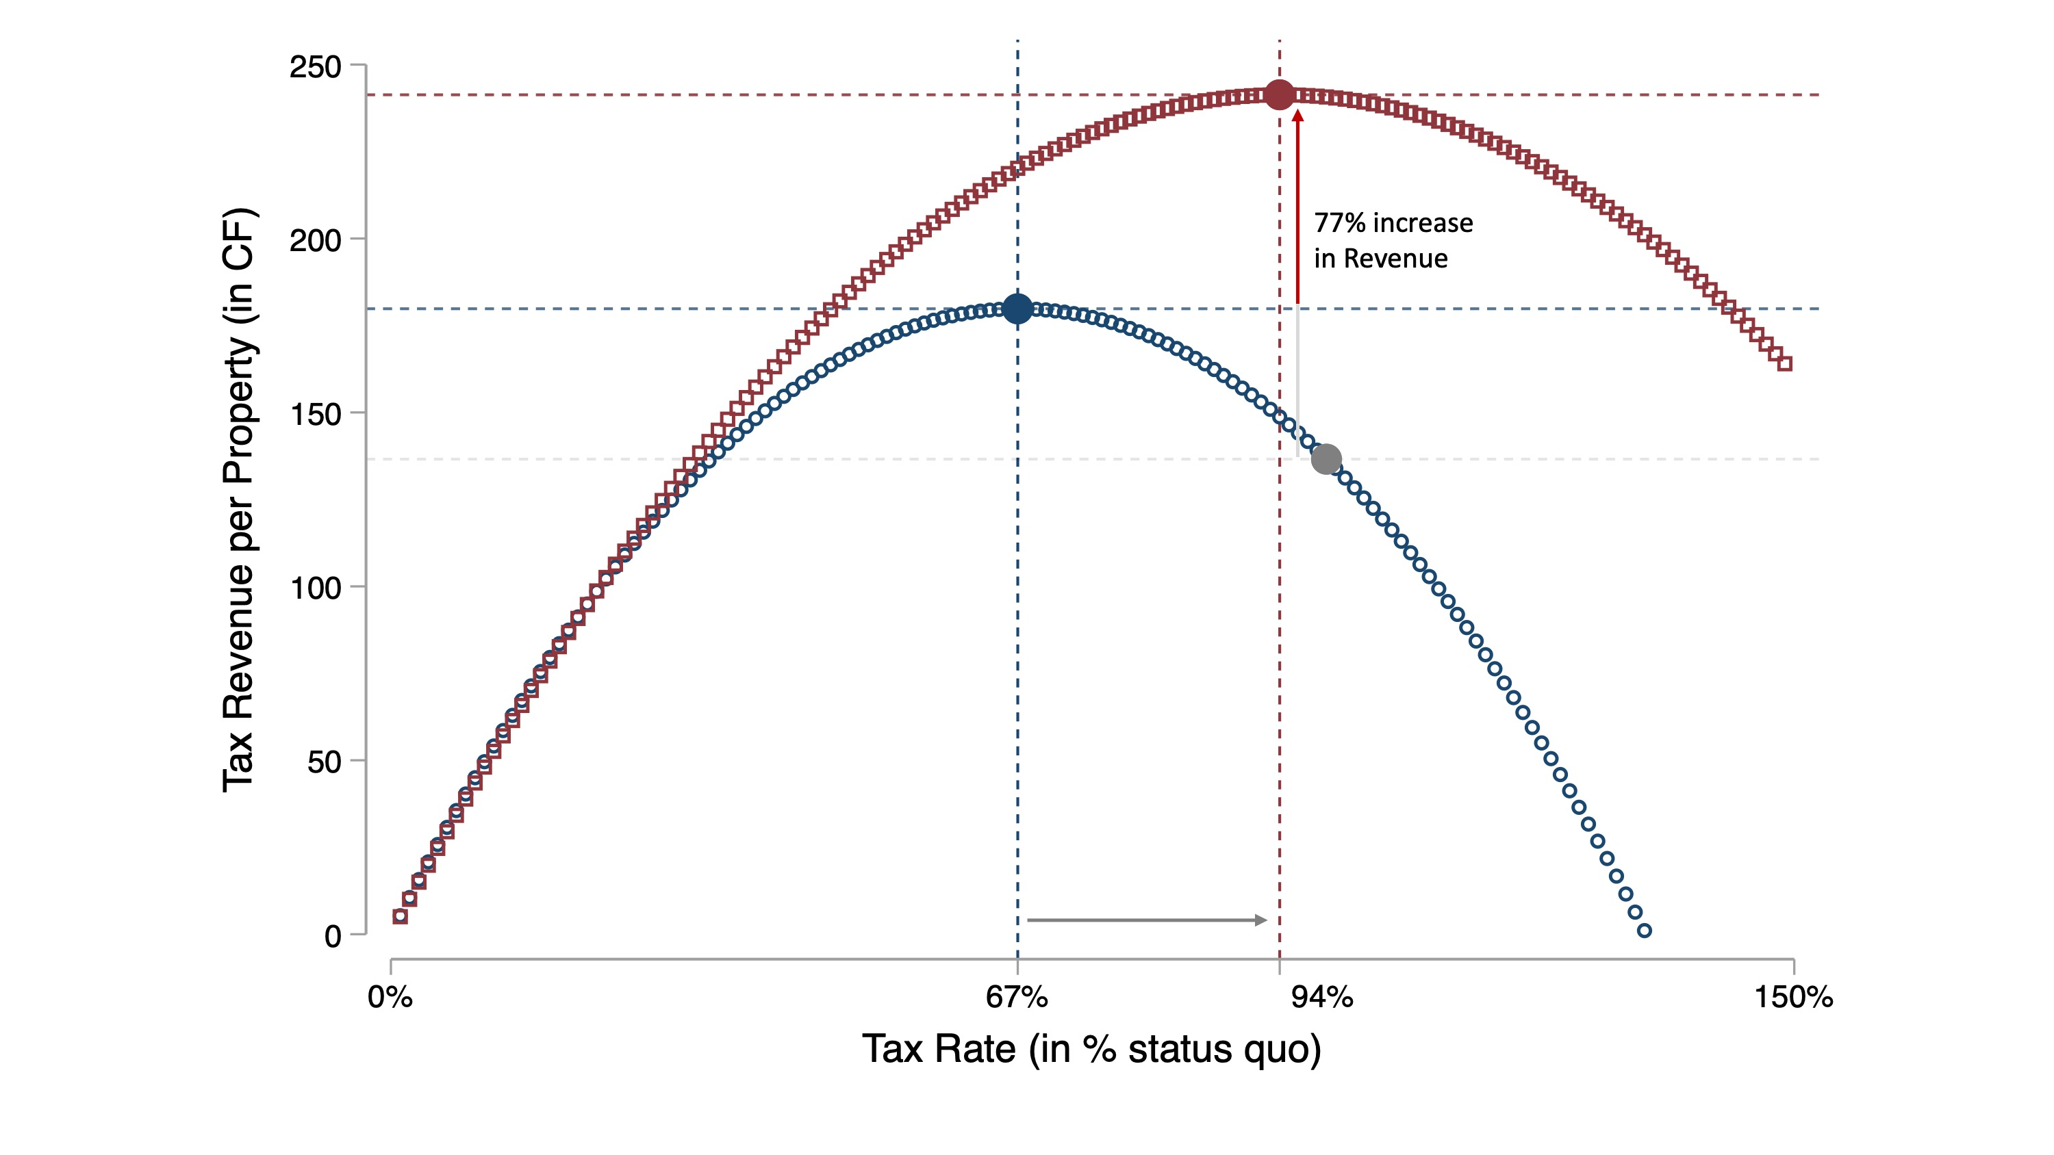
Policy Lesson: Jointly Adjusting Rates and Enforcement

Slide 26
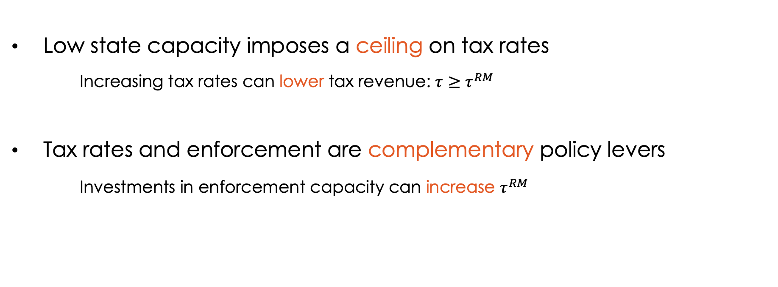
Policy implications
Low state capacity imposes a ceiling on tax rates
  Increasing tax rates can lower tax revenue: $τ≥$ $τ^{RM}$
Tax rates and enforcement are complementary policy levers
  Investments in enforcement capacity can increase $τ^{RM}$

Slide 27
Taking stock: building fiscal capacity in weak states
Efforts to extend the tax net boost engagement with the formal state and may thus strengthen the social contract
Collaborations with local leaders can raise tax compliance thanks to their local information without causing excessive bribe taking or backlash against the formal state
Investments in the tax enforcement capacity of the state can increase the tax rate that maximizes tax revenue: tax rates and tax enforcement are complementary levers
Large scope for collaboration between researchers and tax authorities in developing countries to learn how to raise revenue and strengthen the social compact

